Slide 1
Recommendation location for Restaurant in Toronto, Canada
By ……

Slide 2
Business Problem
The aim of this project is to find the interesting point of interest for restaurant business.
Data that help to identify the location that best for new restaurant business.
Most Common category of restaurant in the city.

Slide 3
Target Audience
Investors
Investors who want to invest in the restaurant industry.
Entrepreneur
Entrepreneur who want to start their restaurant business in the Toronto.
Food lowers
Person want identify in which area he/she can find their choice of food.

Slide 4
Data Source
Wikipedia
Postal code, borough and neighbourhood data
Google Geocoder
Geographical coordinates (Longitude, latitude)
Foursquare
Venues near each neighbourhood

Slide 5
Data cleaning
Postal code, borough and neighbourhood data scrapped from the Wikipedia have null values and undefined values were dropped.
Focus on the centre of the Toronto drop the other borough.
Foursquare API response have unreverent information select the useful information.
Filter the restaurant category and drop the other venues category.

Slide 6
Methodology and Exploratory Data Analysis

Slide 7
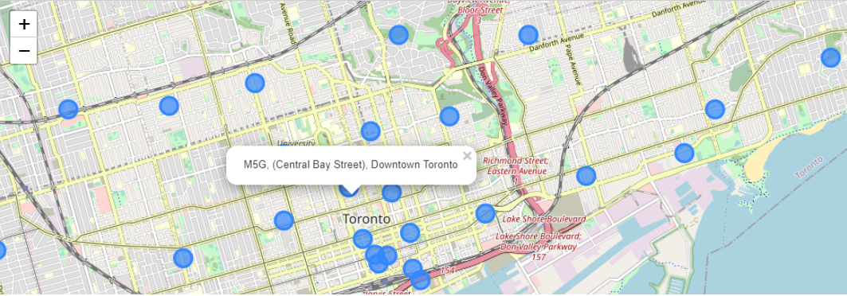
Selected Neighbourhood at Centre of Toronto

Slide 8
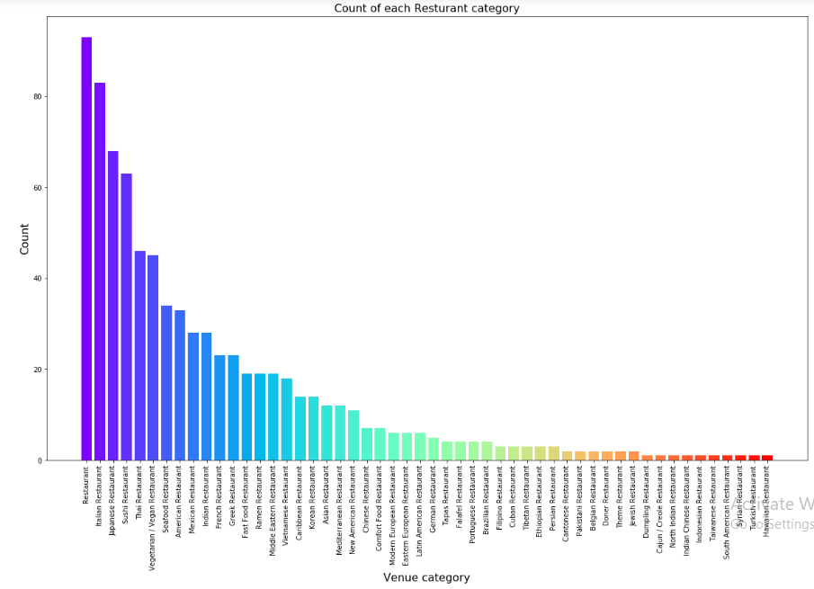
Restaurant categories
277 venues category return by the Foursquare API at our neighbourhood.
Filtering the restaurant category we get 52 unique types of restaurant.
Popular categories of restaurant are general, Italian and the Japanese restaurant.
Least common type of restaurant are Syrian, Turkish and Hawaiian restaurant

Slide 9
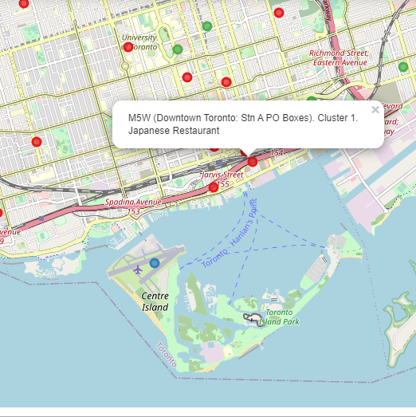
Clustering
Clustering is used to identify the interesting patterns in the data by grouping them based on the common features and the behaviours.
We choose to divide our data into 5 clusters and choose the K-mean clustering.
Figure show us the clusters of restaurant at the neighbourhood and the popup on the neighbourhood show the location and the most common restaurant category.

Slide 10

Results
Restaurant, Italian and Japanese restaurant are the most common restaurant in the central Toronto City and have high competition.
Indian, Mexican and American restaurant have less competition and there is opportunity for these categories.
Syrian, Turkish and Hawaiian restaurants are the least common .
If you are interested in opening Indian restaurant then cluster 1 is best for you because its on the 4th position on the most common list there is a margin for the new restaurant.

Slide 11
Conclusion and Future direction
In restaurant business understand the location customer need and your competitor are the most important factor for the success of the business. From this analysis one can easily understand the Toronto surrounding venues and different location and the competition in the market.
Future Direction Includes:
Include the rating of the restaurant
Distance from the neighborhood
Population at each borough

Slide 12

QUESTIONS

